Slide 1
Software Design for Data Science
Software Architecture & Design Patterns
Melissa Winstanley
University of Washington
March 6, 2025
Notes:
“And” in component design = > code smell

Slide 2
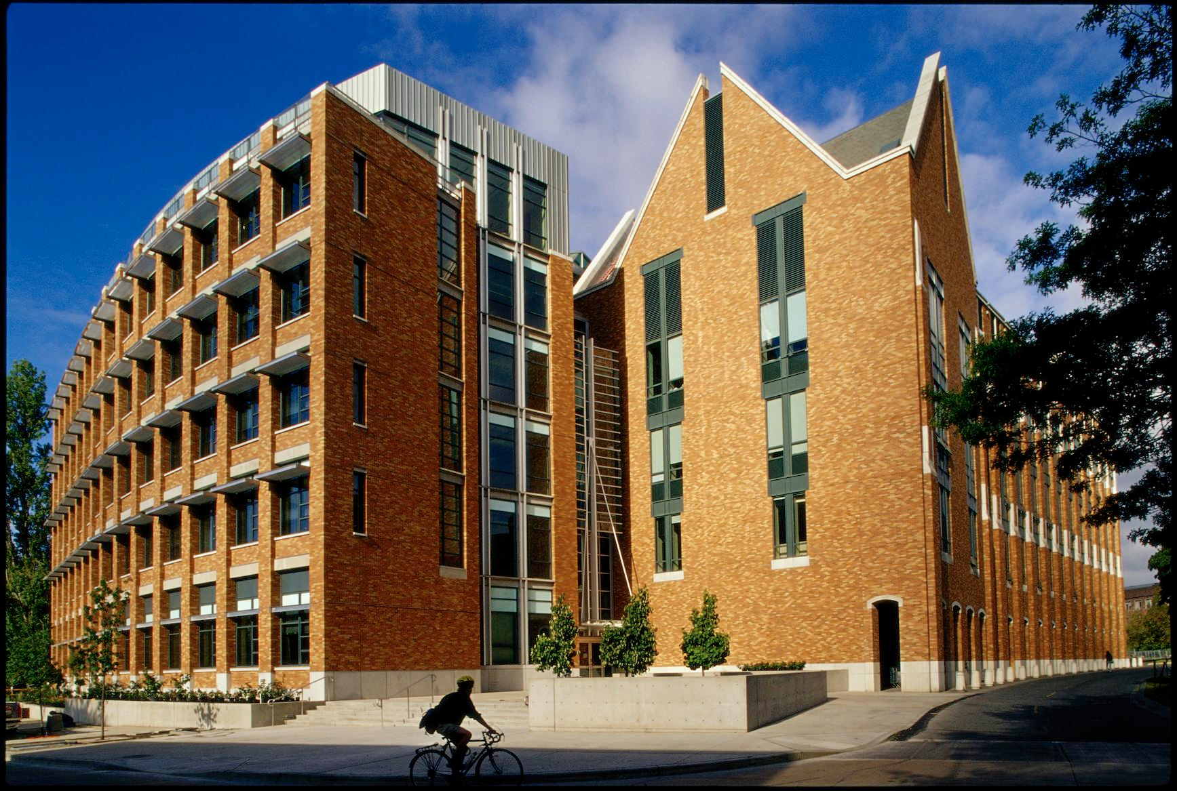
What does “Architecture” make you think of?

Slide 3

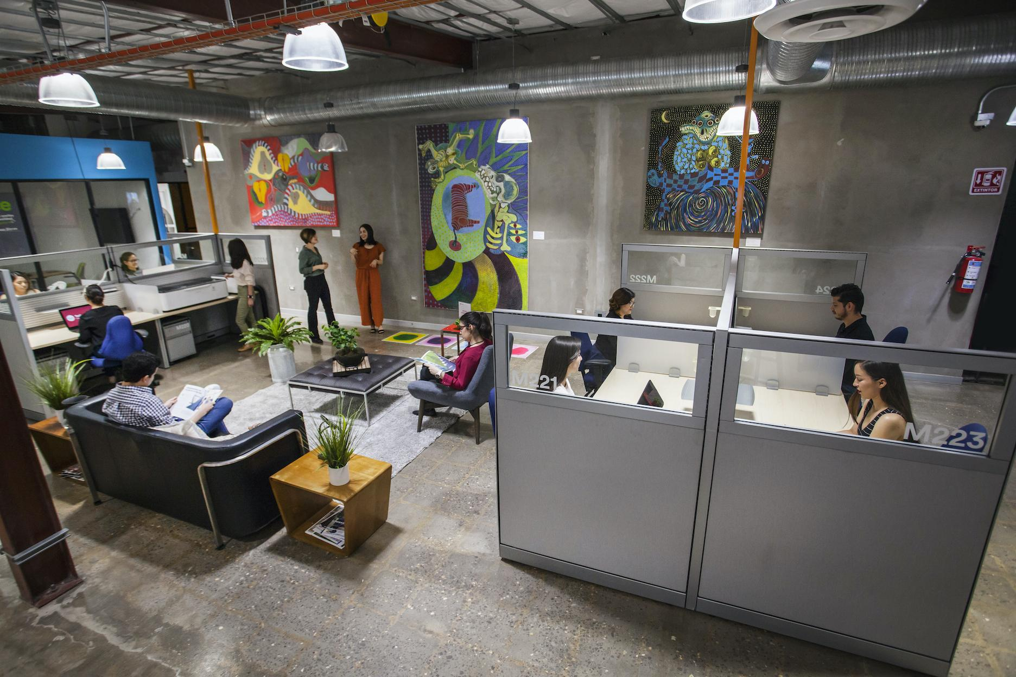
What does “Design” make you think of?

Slide 4
Translation to software
User Stories
Use Cases / Requirements
Development Process
Level of Abstraction
Architecture
Design
Code

Slide 5
Levels of abstraction
Both architecture and design are ABSTRACT.
Ignoring insignificant details
Focusing on most important properties
Considering components and interactions
But what is “insignificant detail” and “important” and “components” changes.
First software design lecture → you probably had several different levels

Slide 6
Software Architecture Patterns

Slide 7
Architecture #1: Pipe & Filter
Pipes pass the data to the next filter, or to the sink
Where the data comes from
src
pipe
Filter
pipe
Filter
pipe
Filter
pipe
sink
Filter does some computation or modification of the data
Some kind of output

Slide 8
Pipe & Filter Example: Code Compiler
File
pipe
Tokenizer
pipe
Parser
pipe
Semantic validation
pipe
Compiled File
pipe
Optimizer
pipe
Bytecode generator

Slide 9

Architecture #2: Client-Server
request
response
request
response

Slide 10
Client-Server pros/cons
Pros:
Sharing between platforms (resources, data, code)
Less data replication
Strong control over the system
Cons:
Networks fail
Server failure -> everything fails
Denial of service

Slide 11
Architecture #3: Layered
Layer 4.1
Layer 4.2
Layers only communicate with the layers directly below them
Layer 3
Clear & limited dependencies
Layer 2
Layer 1

Slide 12
Layered Example: Operating System (Linux)
Application 1
Application 2
System call interface
Kernel
Device drivers
Hardware

Slide 13

Architecture #4: MVC - Model-View-Controller
Data representation
Visualization
Interaction

Slide 14

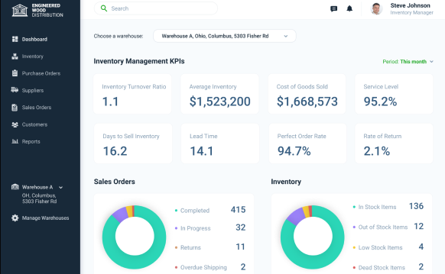

MVC Example: Inventory Management
Controller
View
Model

Slide 15
…and you can combine architecture patterns…

Slide 16
Combination #1: Client-server + layered
Website
Phone app
Presentation layer (UI stuff)
Business logic layer (do things)
Data access layer (data)

Slide 17
Combination #2: Pipe & Filter + MVC
View
src
pipe
Filter
pipe
Filter
pipe
Model
User
Controller

Slide 18
Things to consider in an architecture
Level of abstraction
Key aspects only
Separation of concerns
Strong cohesion WITHIN components
Loose coupling BETWEEN components
“... and …” => CODE SMELL!
Modularity
Decomposable architecture
Composable components
Localized changes
Localized errors

Slide 19
Good architecture helps you succeed!
Architecture helps with…
System understanding
Reuse
Development
Management
Communication/shared vision

Slide 20
Software Design Patterns

Slide 21
Aside: Object-Oriented Design
Object
Data
+
Functionality

Slide 22
Aside: Object-Oriented Design
OO design is NOT required for your project
However!
Some of the same principles apply in functional programming
You will USE objects (eg a Pandas dataframe, dictionaries, etc)
Design patterns can help you write better code
The following examples are simplified; please ask or research for more details

Slide 23
Types of design patterns
Creational patterns
How do you create new objects?
Structural patterns
How do you organize objects?
Behavioral patterns
How do you communicate between objects?

Slide 24
Lazy loading
CREATIONAL
Wait until something is needed to actually load it!
Possible example:
frame = read_csv(‘myfile.csv’) analysis1 = do_some_stuff_with_column_1(frame) analysis2 = do_some_stuff_with_column_2(frame)
Don’t actually read in the whole file yet
Now read column 1
Now read column 2

Slide 25
Singleton
CREATIONAL
Globals => editable by other code
But I only want one!
In module Data:
__database = None
def getInstance() { if __database is None: __database = loadDB() return __database
What’s the problem here?

Slide 26
Builder
CREATIONAL
Separate OBJECT CREATION from OBJECT REPRESENTATION
house = House(windows,doors,rooms,hasGarage,hasSwimmingPool,...)
versus
house = makeHouse() .addWindows(4) .addDoors(2) .addRooms(2) .addGarage() .build()
constructor (tied to a particular type of object)
builder (blueprint)

Slide 27
Immutability
STRUCTURAL
Create an object, but don’t let anyone change its state.
Example?
Tuples! Strings!
In Python, this is HARD
Why?
Possible approaches:
Use tuples where possible
Check out @dataclass(frozen=True)

Slide 28
Decorator
STRUCTURAL
Add behavior to an object, but don’t change its underlying implementation.
Example?
@mock.patch(‘math.cos’) def test_basic_mock(self, mock_cos):
This adds behavior to your test function:
Create a new “fake cosine function”
Replace the real cosine function with the fake
Pass the fake function into your test

Slide 29
Iterator
BEHAVIORAL
Decouple container (list, set, dictionary, more complicated object…) from how you go through its elements
Simplest: for value in lst:
But you can implement your own for your own containers! In whatever order
Container
a, b, c, d, e, …
Iterator

Slide 30
Observer
BEHAVIORAL
Subject maintains list of observers
Update data
Subject
Observers: 1, 2, 3
Update data
Update data
Update data
Observer 1
Observer 2
Observer 3

Slide 31
Strategy
BEHAVIORAL
Separate ALGORITHM (how it works) from OPERATION (what it is doing)
def travelTimeWalking(Loc a, Loc b)
def travelTimeDriving(Loc a, Loc b)
def travelTimeBiking(Loc a, Loc b)
versus
def travelTime(TransportationStrategy strategy, Loc a, Loc b):

Slide 32
Data Access Object (DAO)
BEHAVIORAL
Separate data access code from business logic/“do stuff code”
Translates underlying data format to usable “objects”
Business logic
What does this structure remind you of?
Example: Product (in the inventory)
get/setName()
get/setPrice()
get/setQuantity()
save()
DAO
Database/CSV

Slide 33
More patterns
Wikipedia
Python Patterns Guide
“Gang of Four” Design Patterns book

Slide 34
Exercise: architecture/design patterns in your project
Consider your component design:
Do you see any of today’s architecture or design patterns in your design so far?
How might you make your design stronger with one of today’s patterns?
Improving “separation of concerns”
Improving modularity
Improving abstraction
Note any patterns you see in one of the documents in your docs folder - either the component spec or a new document.

